Slide 1


Slide 2
What is HTML?
HyperText Markup Language
Represents what is seen on the page
layout and everything

Slide 3
What are elements
Elements are what you use to construct HTML pages
Each element has a different purpose or use
a
anchors
for links
div
container of texts, other elements
h1 - h4
Headers
img
images
p
paragraphs

Slide 4
Something to note
Attributes are little “add-ons” for elements and define behavior for the html files
href
defines that when this element is clicked on, the user will be sent to the proper HTML page
style
Defines styles for the element

Slide 5
Workshop Rehash
Go ahead and create an HTML page that has your name and a phrase that describes you
Along with an image that links to a social media profile

Slide 6
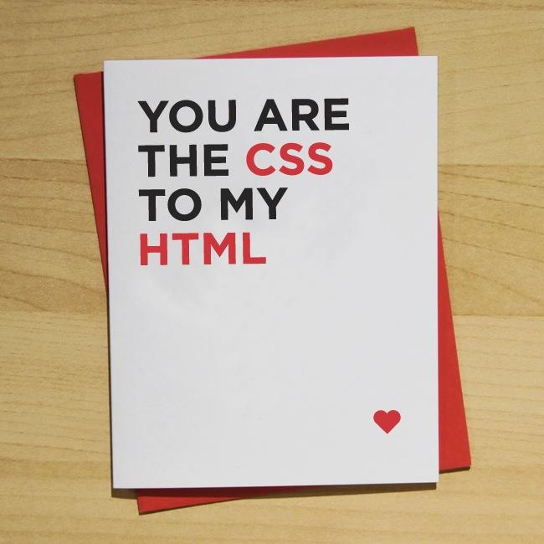
What is CSS?
Cascading Stylesheets
Complementary to HTML
Makes your sites not so boring
Add “styles” to your webpage
Two Ways
Inline-Styles
NO
External CSS File

Slide 7
How do I use an external CSS file?
<link href=”name-of-css-file.css” type=”text/css” rel=”stylesheet”>
Type and rel basically tell information about the CSS file

Slide 8
What is an ID?
Identifier
Allows you to target one specific element

Slide 9
Example
//index.html
<div id=”name”>NAME</div>
//styles.css
#name {
color: cornflowerblue;
}

Slide 10

What is a class?
Used whenever you want to apply the same style to different places
NOT Unique

Slide 11
Example (w/ Class)
//index.html
<h1 class=”center”>Title</h1>
<p class=”center”>Another description</p>
//styles.css
.center {
text-align: center;
}

Slide 12
Example (w/ ID)
//index.html
<h1 id=”center1”>Title</h1>
<p id=”center2”>Just another description</p>
//styles.css
#center1 {
text-align: center;
}
#center2 {
text-align: center;
}

Slide 13
YOU DO IT!
Try implementing these classes in your HTML page that you created earlier!

Slide 14
Alright, So which one do I actually use?
Classes. Hands-down
Why?
Styles applied to one element may want to be replicated to other elements as well

Slide 15
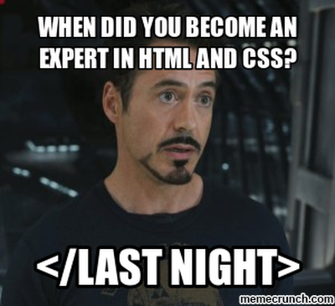
You’re Now an Expert!

Slide 16
Questions?

Slide 17
Feedback
bit.ly/beginner-feedback

